Slide 1

Creating a Scalable To-Do Application
Presented by
Dhanasoorya M (912421106005)
Ganesh J (912421106006)

Slide 2
Abstract
Developing a scalable and efficient to-do application as a Software-as-a-Service (SaaS) offering requires careful planning and a strategic approach. This presentation will guide you through the key aspects of creating such an application, from the frontend technologies to the overall system architecture and deployment considerations. The application incorporates responsive design principles, making it accessible across desktop, tablet, and mobile devices, ensuring seamless usability regardless of platform. Scalability is achieved by integrating HTML with robust backend technologies through RESTful or GraphQL APIs, enabling the application to handle an increasing number of users and tasks. Cloud-based databases such as Firebase, MongoDB, or PostgreSQL store user data securely while ensuring high availability.

Slide 3

Project Overview
1
Streamlined Task Management
2
Scalability and Reliability
Provide users with a user-friendly interface to easily create, organize, and track their tasks and to-do items.
Ensure the application can handle increasing user demand and workloads without compromising performance or availability.
3
Cross-Platform Accessibility
Allow users to access and manage their tasks from any device, whether desktop or mobile, through a responsive and consistent user experience.

Slide 4



Frontend Technologies: HTML, CSS, and JavaScript
HTML
CSS
JavaScript
Provide the structure and semantic markup for the application's user interface elements.
Style the application's visual appearance, ensuring a consistent and responsive design across devices.
Implement interactive and dynamic features, such as task creation, updating, and real-time updates.

Slide 5
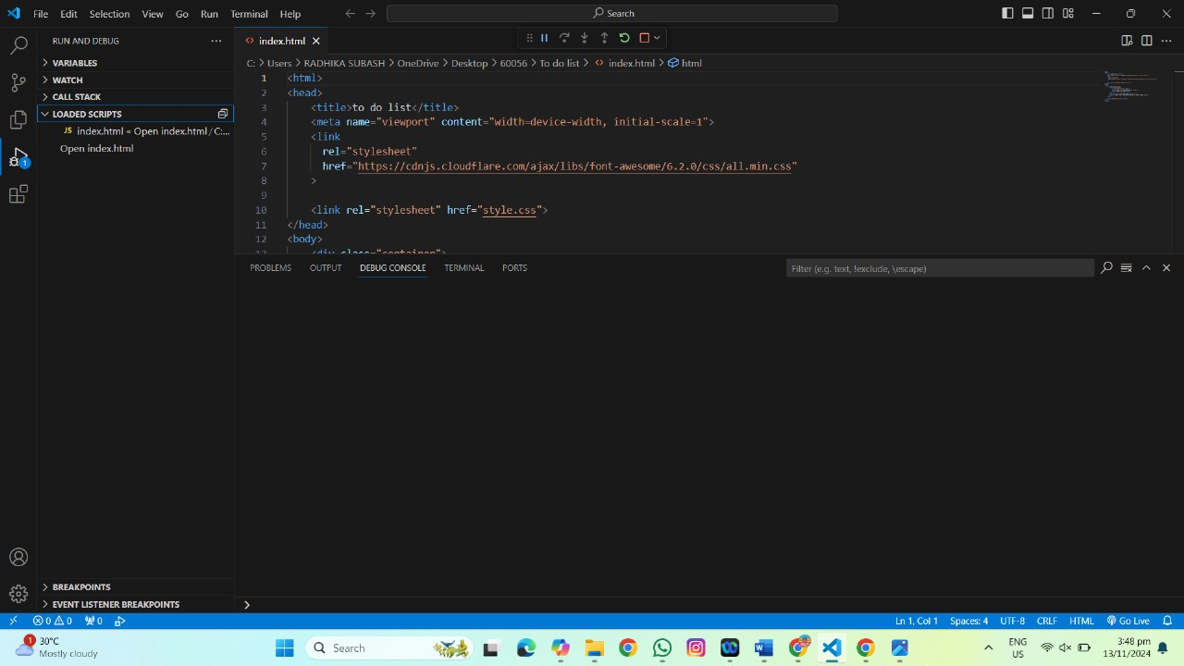
HTML CODING

Slide 6
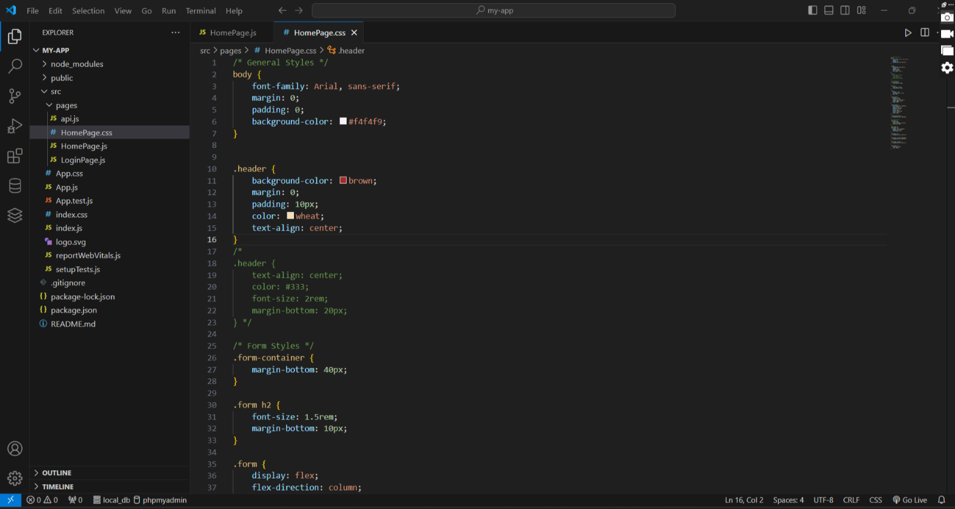
CSS CODING

Slide 7
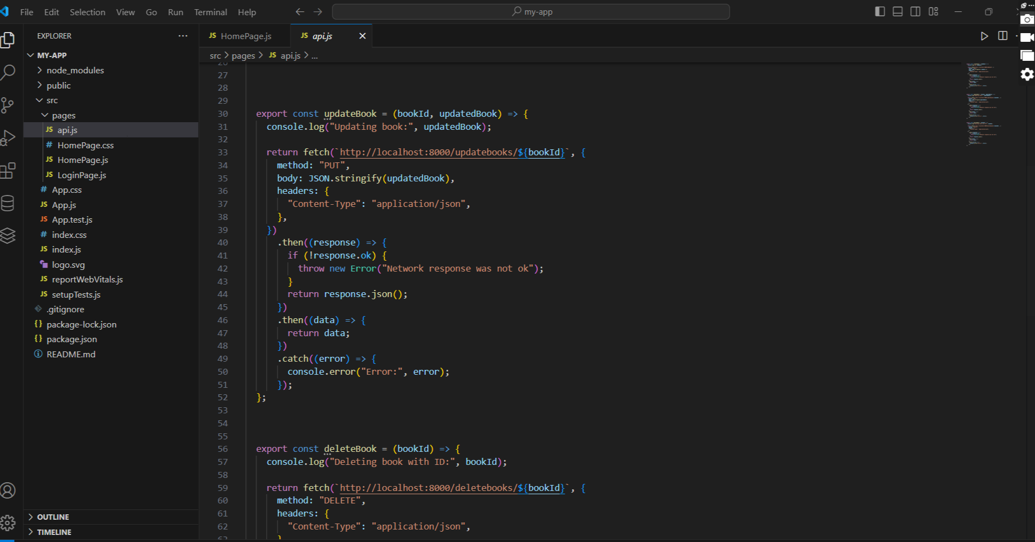
JAVASCRIPT CODING

Slide 8
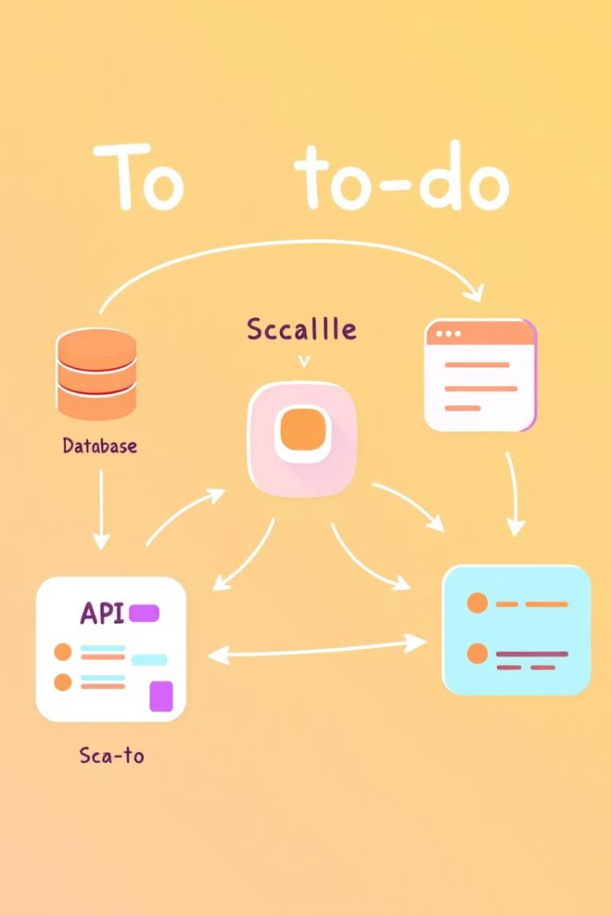
Application Architecture and System Flow
1
Client-Server Model
The application follows a client-server architecture, with the frontend client communicating with the backend server.
2
Data Synchronization
Real-time updates and synchronization between the client and the server ensure data consistency across devices.
3
Scalable Infrastructure
The system is designed to scale horizontally, allowing for increased user demand and concurrent connections.

Slide 9
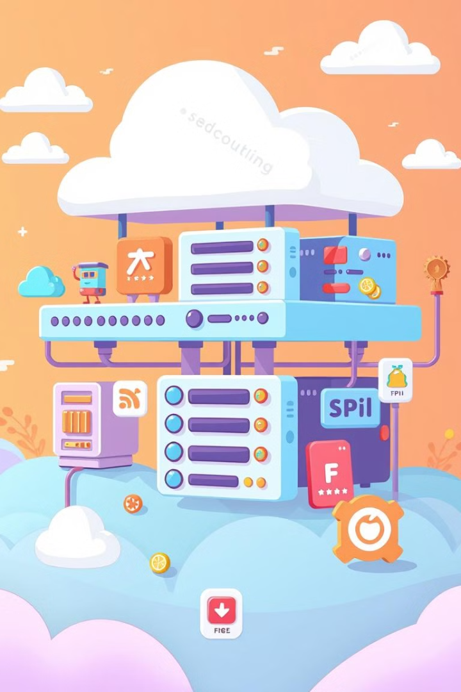



Scaling Strategies: Handling Increased User Demand
Vertical Scaling
Increase the computing power and resources of individual server instances to handle more concurrent users and data.
Horizontal Scaling
Add more server instances to the application's infrastructure, distributing the workload and increasing overall capacity.
Caching and Optimization
Implement caching mechanisms and optimize application code and database queries to improve response times and reduce server load.

Slide 10




Security and Access Control Mechanisms
User Authentication
Authorization Levels
Data Encryption
Implement secure user authentication, such as password-based or social media login, to protect user accounts.
Establish different user roles and access levels to control what actions users can perform within the application.
Encrypt sensitive user data, such as passwords and task details, to ensure the privacy and confidentiality of user information.

Slide 11
User Interface and Experience Design
Responsive Design
Task Prioritization
Intuitive Interactions
Ensure the application's user interface adapts seamlessly to different screen sizes and devices, providing a consistent experience.
Implement features that allow users to easily categorize, filter, and prioritize their tasks based on due dates or other criteria.
Design intuitive interactions, such as drag-and-drop task management and real-time task updates, to enhance user productivity.

Slide 12

Implementation Challenges and Solutions
1
Scalable Backend
2
Real-Time Updates
Ensure the backend architecture can handle increased user demand and data volume without compromising performance.
Implement efficient real-time data synchronization mechanisms to provide users with instant task updates across devices.
3
Testing and Monitoring
Establish comprehensive testing and monitoring processes to identify and address any performance or security issues.

Slide 13
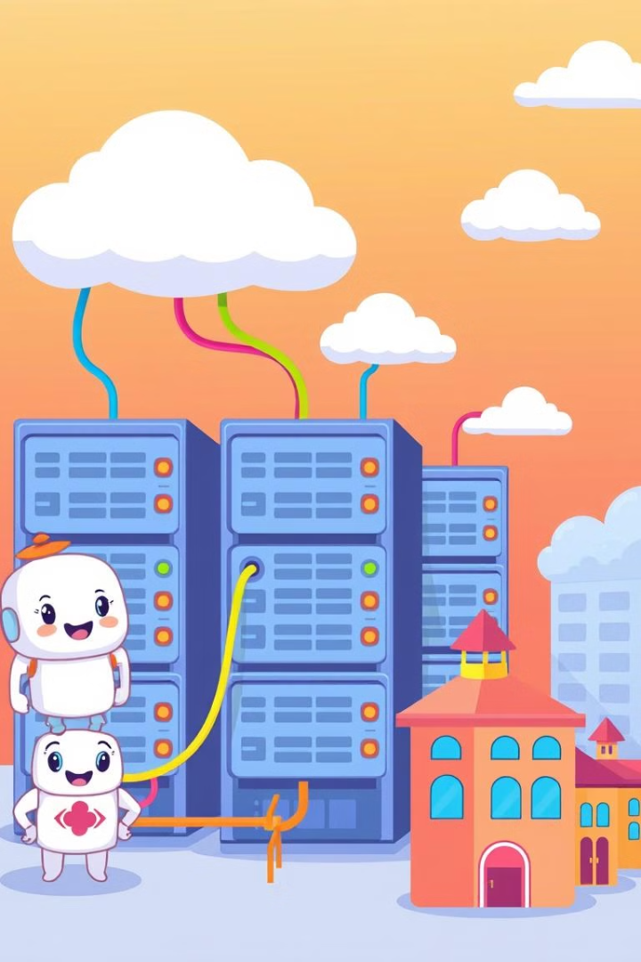
Deployment and Maintenance Best Practices
Containerization
Package the application and its dependencies into lightweight, portable containers for consistent deployment.
Automated Deployments
Implement a continuous integration and deployment (CI/CD) pipeline to streamline the release process.
Monitoring and Logging
Continuously monitor application performance, user activity, and system health to identify and address issues promptly.
Disaster Recovery
Ensure the availability of critical data and services by implementing robust backup and disaster recovery strategies.

Slide 14
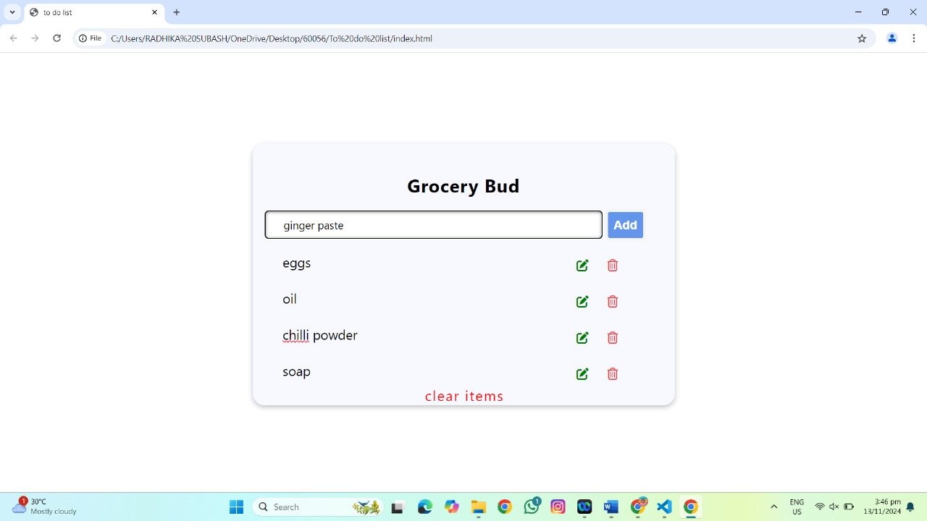
Interface of the Scalable To-Do Application

Slide 15
Conclusion
The "Scalable To-Do Application using SaaS" project successfully demonstrates the power of cloud-based software in delivering a seamless, responsive, and highly customizable productivity tool for users at any scale. By leveraging SaaS principles, this application is not only robust in terms of handling increasing user loads but also dynamic in catering to individual and organizational needs. The application's foundation on microservices architecture allows for specific task functionalities—such as task management, notifications, and user authentication—to operate independently. This design enhances the modularity of the system, facilitating smooth updates, fault tolerance, and scalability. With separate microservices for user management, task notifications, and API gateways, the system can easily scale horizontally by adding more instances of each service as demand grows, ensuring continuous uptime and low latency even under high loads.

Slide 16
THANK YOU

